Slide 1
Bike Sharing Demand Analysis
Bike Sharing Demand Analysis
Next Hikes IT Solutions
Name : SABA AFREEN KAZI Course : AI AND DATA SCIENCE Date : 25.03.2026

Slide 2
Introduction
This helps improve resourse allocation and demand prediction
The analysis is based on hourly rental data over a period of one year .
The dataset is collected from a public bike sharing system

Slide 3
Problem Statement
Rental demand is often unpredictable and fluctuates significantly.
The rental demand is often unpredictable making it difficult to ensure optimal bike availability.
The objective is to analyze these patterns to improve planning and business decision making

Slide 4
Dataset Overview
The dataset contains hourly and daily bike rental data.
Main columns:
Date (dteday)
Hour (hr)
Weather (weathersit)
Temperature (temp)
Users (casual, registered)
Total Rentals (cnt)

Slide 5
Data Cleaning
Checked and handle missings values .
Removed duplicated records .
Corrected data types ( data,numerical,fields)
Standardized column formats .
Verified data consistency and accurancy.

Slide 6
Data Merging
Merged 3 datasets using power Query
Joined datasets usings commonkeys
Instant,dteday,and hr
Created a single consolidated dataset for analysis.

Slide 7
Key Features Created
Weekend / Weekday classification
Demand Level (High / Low)
Temperature category (Hot / Cold / Moderate)

Slide 8
Analysis - Hourly Demand
Peak demand observed during morning and evening hours
Low demand during late night
Useful for scheduling bikes efficiently

Slide 9
Analysis - Weather Impact
Clear weather shows highest rentals
Rainy or bad weather reduces demand
Weather plays a key role in rentals

Slide 10
Analysis - Monthly Trend
Demand increases during summer months
Lower demand in winter
Seasonal patterns are clearly visible

Slide 11
User Analysis
Registered users contribute more Rentals
Casual users mainly active on weekends
Shows difference in user behavior

Slide 12
Dashboard Overview
Interactive dashboard created using ExcelI
Ncludes multiple charts and slicers
Helps in dynamic data filtering and insights

Slide 13
Tools Used
Microsoft Excel
Pivot Tables
Power Query
Charts and Visualization
Slicers for interactivity

Slide 14
Conclusion
Bike demand depends on time, weather, and user type
Peak hours and seasons identified
Data helps improve business planning and decision-making

Slide 15
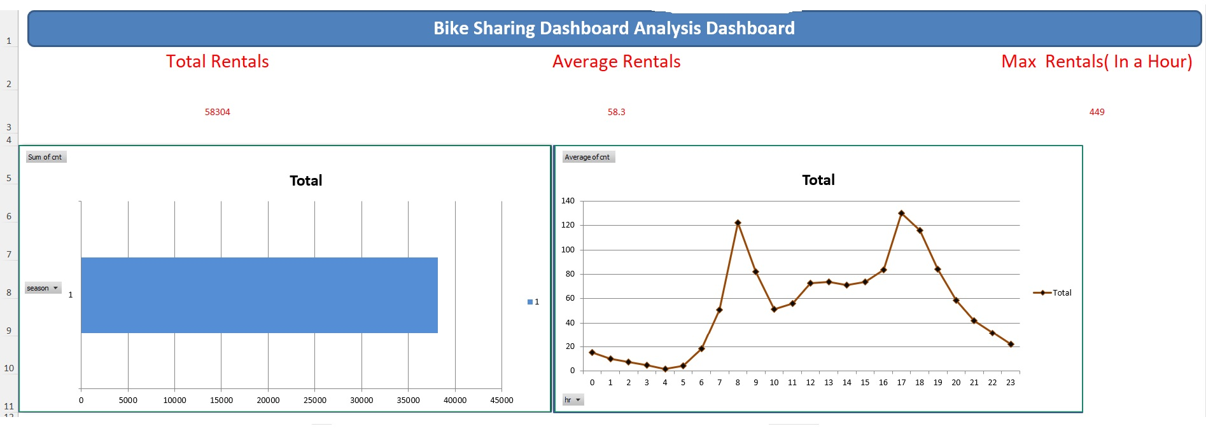

Slide 16
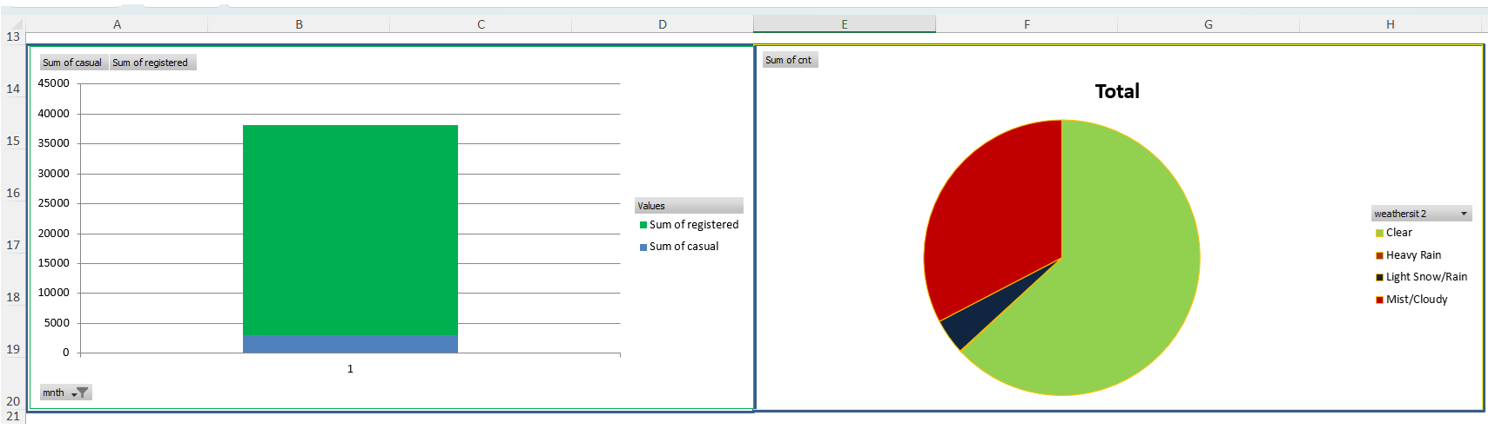

Slide 17
